Slide 1
ESSA
Every Student Succeeds Act

Slide 2
ESSA
Every Student Succeeds Act
$1.6 Billion

Slide 3
Tonight
October
unlikely ever

Slide 4
Every Student Succeeds Act
ESSA provides external measures on how well our internal actions
are helping our students succeed.
A mechanism for increased equity.

Slide 5
Similar to RtI
IF:
1- identify highly effective practice
2- compare your school’s current functioning
3-develop a plan to address the identified gaps
4-provide resources to implement the plan
5-assess the plan regularly and revise when needed
6-add additional supports if low performance isn’t improving
THEN:
the gap in achievement will be eliminated

Slide 9
Informational Purposes Only

Slide 11
Academic Achievement
Graduation Rate
ELL Proficiency
College, Career & Civic Readiness
Chronic Absenteeism

Slide 12
NYS has established a long term goal for 2021-22 of closing gaps by 20%.
Goals are set at the State, District, and School Level for each subgroup

Slide 13
Closing the ______ Gap with the End Goal by 20%
-Achievement
-Graduation
-Proficiency
Baseline performance (16-17 data)
100
End Goal (21-22 data)
200
+ Yearly Goal to reduce the gap
+ 4
- Baseline performance (16-17 data)
- 100
1st Year MIP 17-18
104
Gap to the end goal
100
+ Yearly Goal to reduce the gap
+ 4
x 20% (expected reduction)
x 20%
2nd Year MIP (18-19)
108
+ Yearly Goal to reduce the gap
+ 4
Long Term Goal to reduce the gap
20
3rd Year MIP (19-20)
112
÷ 5 (5 years to 21-22)
÷ 5
+ Yearly Goal to reduce the gap
+ 4
Yearly Goal to reduce the gap in 5 yrs
4
4th Year MIP (20-21)
116
+ Yearly Goal to reduce the gap
+ 4
Use this to calculate MIPs
Measures of Interim Progress
120
5th Year MIP (21-22)

Slide 14
NYS’s accountability system will use a variety of indicators beyond core academic subjects
For All Schools
*ELA
*Math
*Science
*Progress for ELLs
*Chronic Absenteeism
For High Schools
*Social Studies
*Graduation Rate
*College, Career, and Civic Readiness
In the Future
*Out of School Suspensions
*Readiness for High School

Slide 16
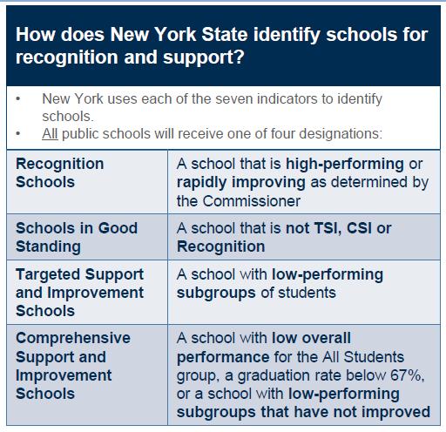

Slide 17
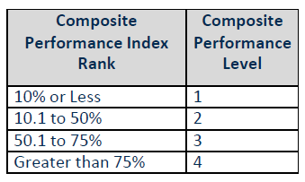
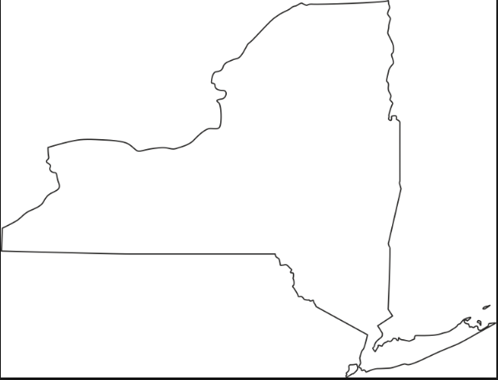
MULTIPLE MEASURES
>75%.......Level 4
50.1-75%.......Level 3
95% students
10.1-50%.......Level 2
only tested students
≤10%.......Level 1

Slide 19
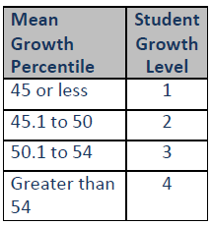
MULTIPLE MEASURES
>54.......Level 4
50.1-54.......Level 3
45.1-50.......Level 2
Mean Growth Percentiles
≤45.......Level 1

Slide 20
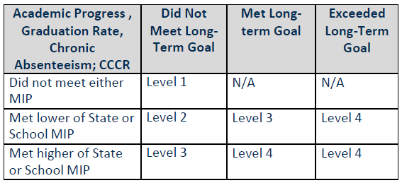
MULTIPLE MEASURES
Long Term Goal
Measures of Interim Progress

Slide 21
MULTIPLE MEASURES
Long Term Goal
4 Year/5 Year/6 Year
Measures of Interim Progress

Slide 22
MULTIPLE MEASURES
Long Term Goal
≥10%
Measures of Interim Progress

Slide 23
MULTIPLE MEASURES
Long Term Goal
Measures of Interim Progress

Slide 25
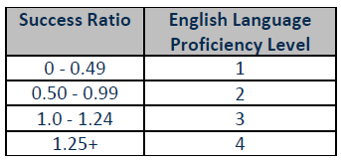
MULTIPLE MEASURES
Entering | Emerging | Transitioning | Expanding | Commanding
1 | 2 | 3 | 4
1 | 2 | 3 | 4
1 | 2 | 3 | 4
1 | 2 | 3 | 4
Proficient
.25
.25
.25
.25
.25
.25
.25
.25
.25
.25
.25
.25
.25
.25

Slide 26
Comparison to State and local long term goals and MIPs

Slide 27
Comparison to State and local long term goals and MIPs

Slide 28
ESSA

